Slide 1

A MINI PROJECT ON Mitigating DDOS Attack In IOT Network Environment (Submitted in partial fulfilment of the requirements for the award of Degree) BACHELOR OF TECHNOLOGY IN COMPUTER SCIENCE AND ENGINEERING BY BATCH:01 PALNATI SRAVANI 207R1A05N1 GODUGU VENKATESHWARLU 207R1A05L3 PENDLI KARTHIKEYA 207R1A05N4 Under the Guidance of DR.K. SRUJAN RAJU DEPARTMENT OF COMPUTER SCIENCE AND ENGINEERING CMR TECHNICAL CAMPUS UGC AUTONOMOUS (Accredited by NAAC, NBA, Permanently Affiliated to JNTUH, Approved by AICTE, New Delhi) Recognized Under Section 2(f) & 12(B) of the UGC Act.1956, Kandlakoya (V), Medchal Road, Hyderabad-501401. 2020-2024

Slide 2
ABSTRACT
The rise of Internet of Things (IoT) devices has brought about new challenges in terms of security. One major concern is the Weakness of these devices to Distributed Denial of Service (DDoS) attacks.
Machine learning (ML) algorithms have emerged as a potential solution to this problem.
By analyzing network traffic patterns, ML algorithms can detect and mitigate DDoS attacks in real-time, providing a quick response to prevent significant damage.
This abstract explores the advantages of using ML algorithms in mitigating DDoS attacks in IoT devices.
It discusses the benefits of real-time detection and automated response, which can help minimize the impact of an attack and reduce the workload on security personnel.

Slide 3
EXISTING SYSTEM
Blockchain technology can help mitigate DDoS attacks in IoT by providing a decentralized and transparent system for managing network traffic.
For example, Blockchain can enable real-time monitoring and analysis of network traffic, which can help identify and respond to potential threats more quickly. Blockchain can also provide a secure and tamper-proof record of network activity, which can be used to investigate and prosecute cybercriminals.
One existing Blockchain system for mitigating DDoS attacks in IoT is the Fog Computing-based Blockchain (FCB) system.
FCB utilizes a fog computing architecture to distribute the computational load across multiple devices, reducing the burden on individual IoT devices.
This helps to mitigate the risk of DDoS attacks by ensuring that no single device is overwhelmed by incoming traffic.

Slide 4
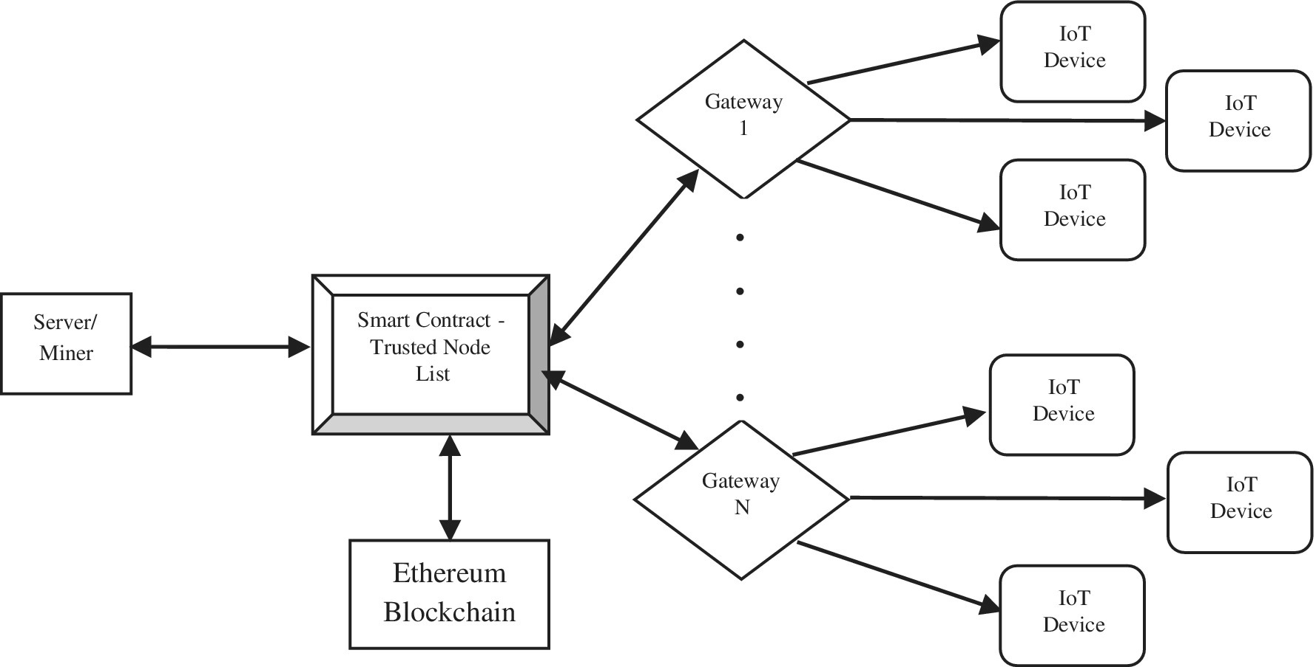
BLOCK DIAGRAM

Slide 5
DISADVANTAGES OF EXISTING SYSTEM
Limited Scalability : Large scale attacks cannot be handle.
Cost : DDoS mitigation systems can be expensive to implement and maintain.
Complexity : DDoS mitigation systems will be complex to implement and requires technical knowledge.
Limited Detection Capabilities(LOW EFFICIENCY) : It can detect and identify some of the DDoS attack but cannot identify critical ones.
False positives(LESS ACCURACY) : Sometimes, it will fail to detect the attack.

Slide 6
PROPOSED SYSTEM
For the proposed system of the project ,using algorithms such as SVM, Random Forest, XGBoost , AdaBoost , KNN and Naive Bayes to detect DDos.
Here ,to train the algorithm we are using 10 different attacks of IOT environment as CIC Dataset.
To predict the Accuracy of DDos attack ,test data should be given.
Created some different classes to run the algorithms.

Slide 7
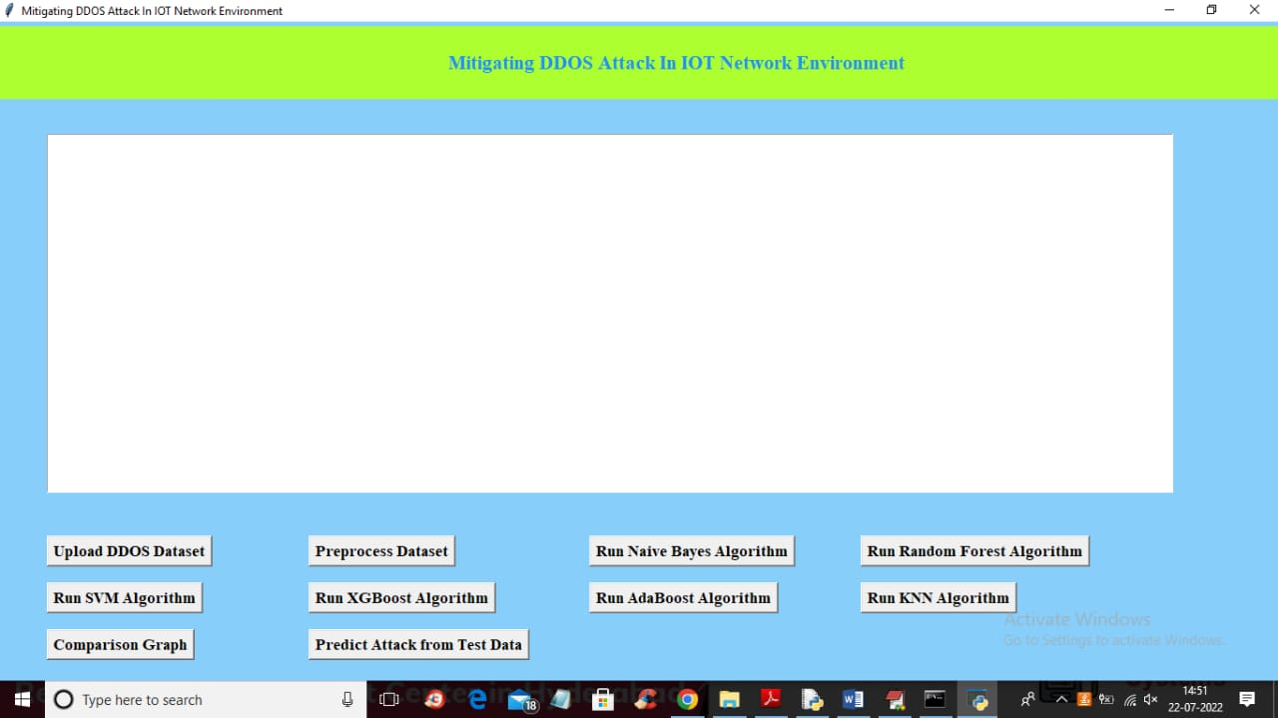
MACHINE LEARNING MODEL

Slide 8
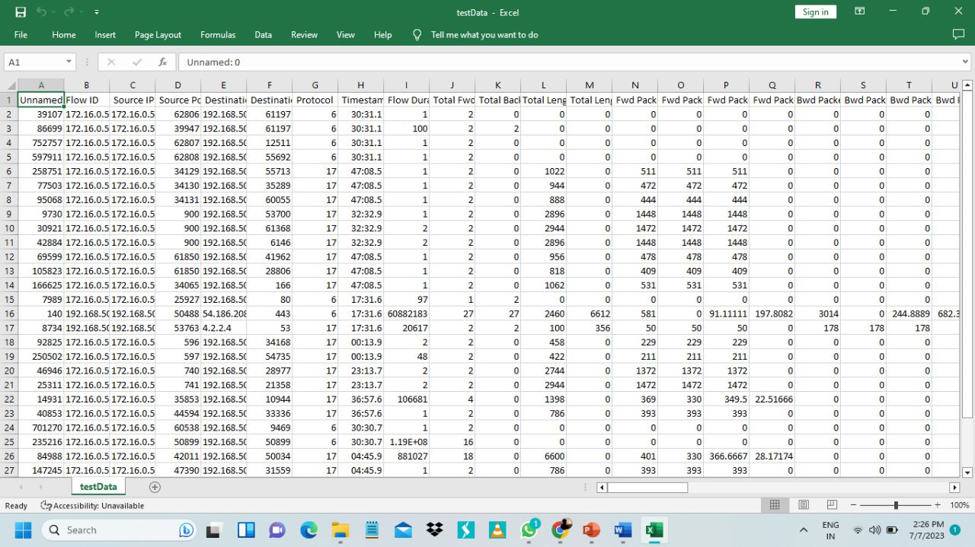
TEST DATA
Test data refers to the data that is used to test a software application.
It is used to check if the software is working as expected and to identify any bugs or errors in the system.
Test data can be of various types, including positive, negative, and boundary test data.

Slide 9
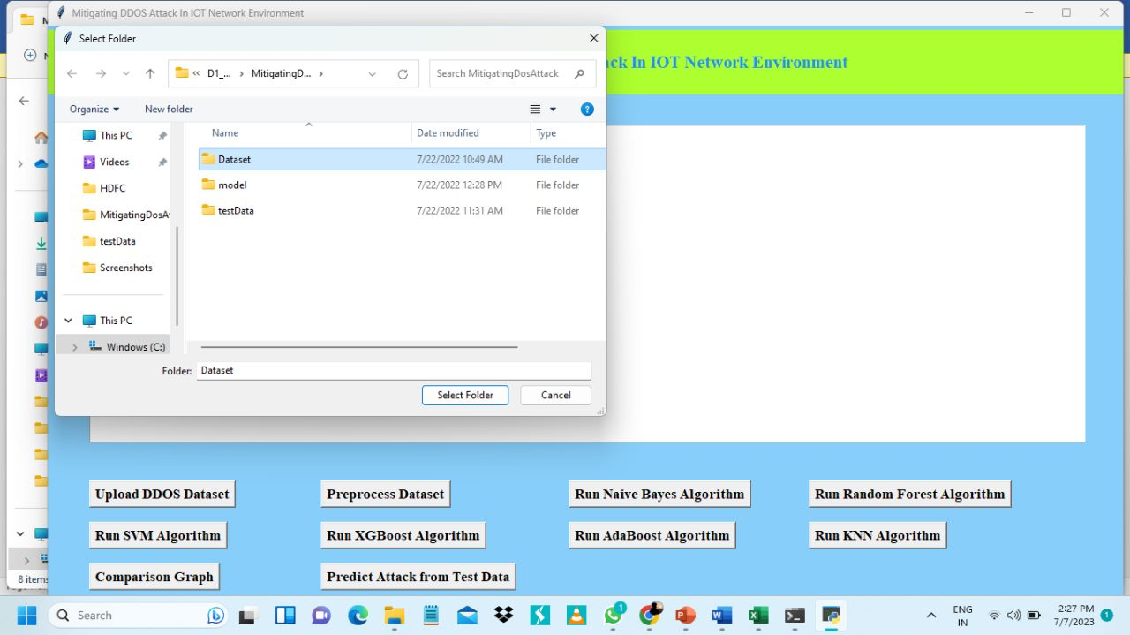
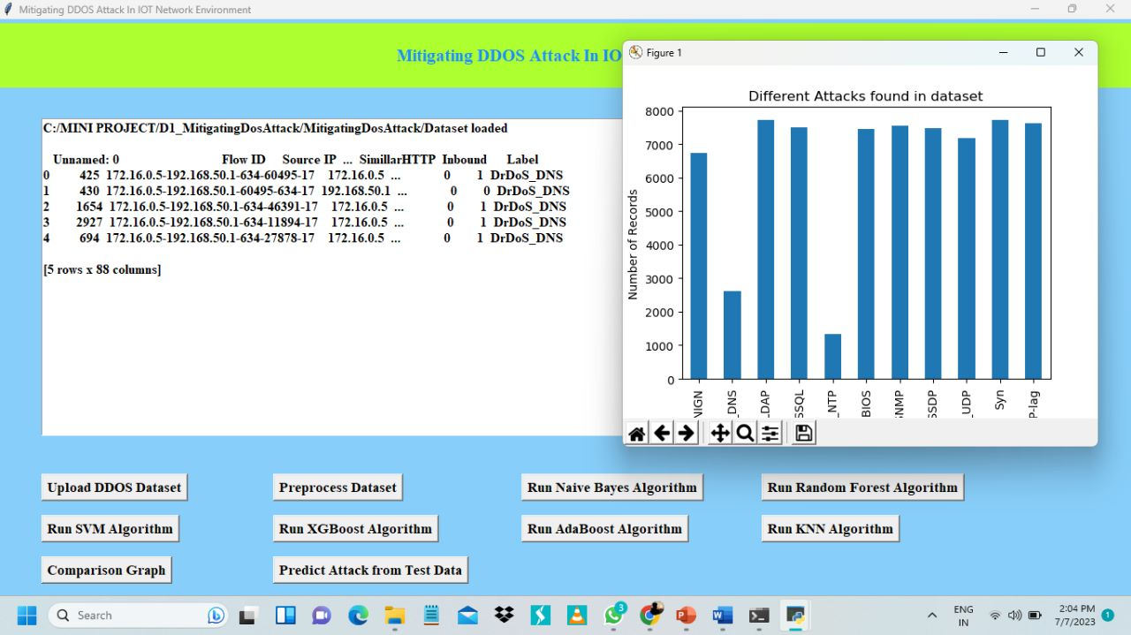
UPLOAD DDOS DATASET
Using this module we can upload dataset and then application will read data from all attacks and plot a graph .
Dataset contains both numeric and non-numeric data.
The dataset contains a large volume of network traffic that simulates an actual DDOS attack, allowing developers to identify any vulnerabilities or weaknesses in the system.

Slide 10
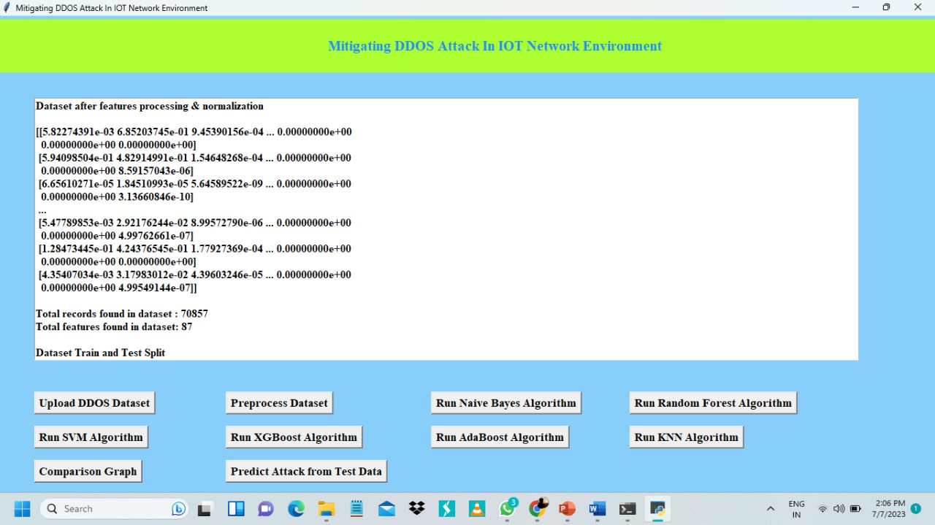
PREPROCESS DATASET
In order to convert non-numeric data ,we will preprocess the data.
Preprocessing a dataset involves cleaning and transforming the raw data into a format that can be easily analyzed.
The preprocessing stage includes tasks such as removing duplicates, handling missing values, and normalizing the data.

Slide 11
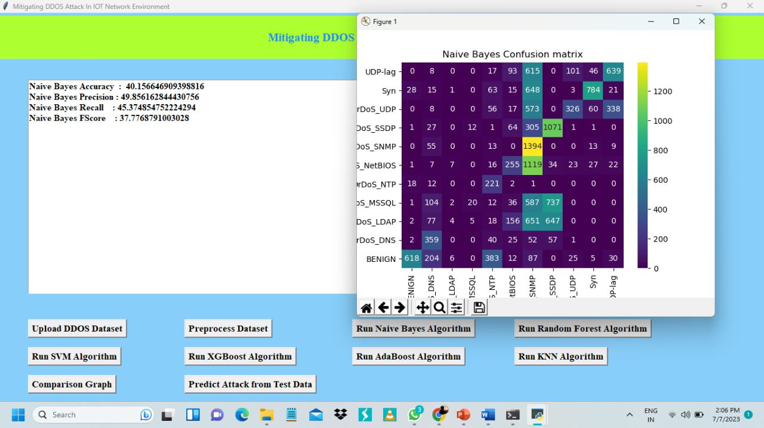
NAVIE BAYES ALGORITHM

Slide 12
NAVIE BAYES ALGORITHM
Naive Bayes is an algorithm used in machine learning for classification tasks.
It is based on Bayes theorem, which states that the probability of an event occurring given some prior knowledge can be calculated using conditional probabilities.
In Naive Bayes, we assume that all features are independent of each other.
Formula: P(A|B) = P(B|A) * P(A) / P(B)
In above screen with Naive Bayes we got 40% accuracy.
In confusion matrix graph x-axis represents PREDICTED classes and y-axis represents TRUE classes.
Here prediction count in same row and column names are the correct prediction and count in different row and column names are the incorrect prediction.
Thus, Naive Bayes prediction have so many wrong prediction.

Slide 13
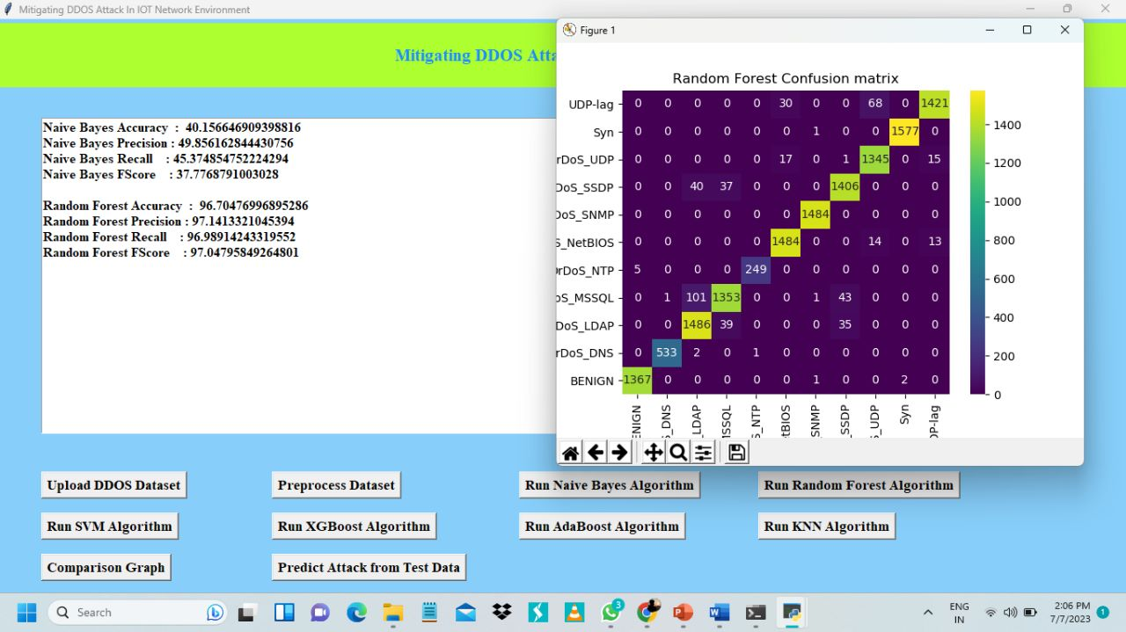
RANDOM FOREST ALGORITHM

Slide 14
RANDOM FOREST ALGORITHM
Random Forest is used in machine learning for classification and regression tasks.
It is an ensemble learning method that combines multiple decision trees to make more accurate predictions.
Random Forest is a powerful algorithm that can handle large datasets with high dimensionality and noisy data.
In above screen with Random Forest we got more than 96% accuracy.
In the graph we can see lots of predictions are correct.

Slide 15
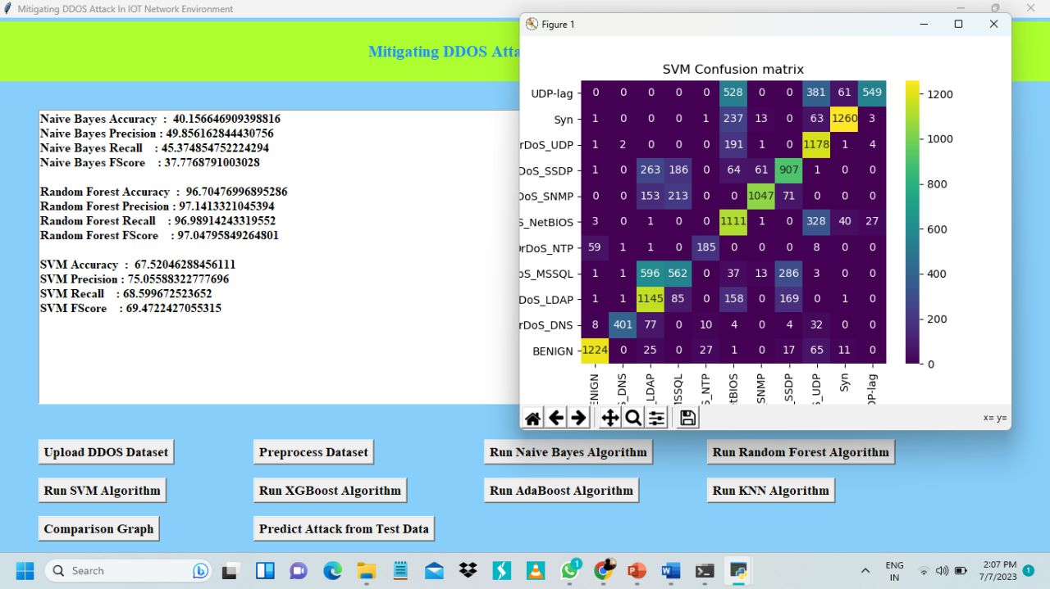
SVM ALGORITHM

Slide 16
SVM ALGORITHM
The Support Vector Machine (SVM) algorithm is a machine learning technique used for classification and regression analysis.
It is a supervised learning model that works by finding the best hyper-plane in a high-dimensional space that separates different classes of data points.
One of the key strengths of SVM is its ability to handle non-linearly separable data.
Formula:1.Linear SVM : f(x) = sign(wx + b)
2. Non-linear SVM : f(x) = sign(yi K(xi, x) + b)
Where,“f(x)” represents the predicted class label for the data point "x.“
The test data with SVM we got 67% accuracy.

Slide 17
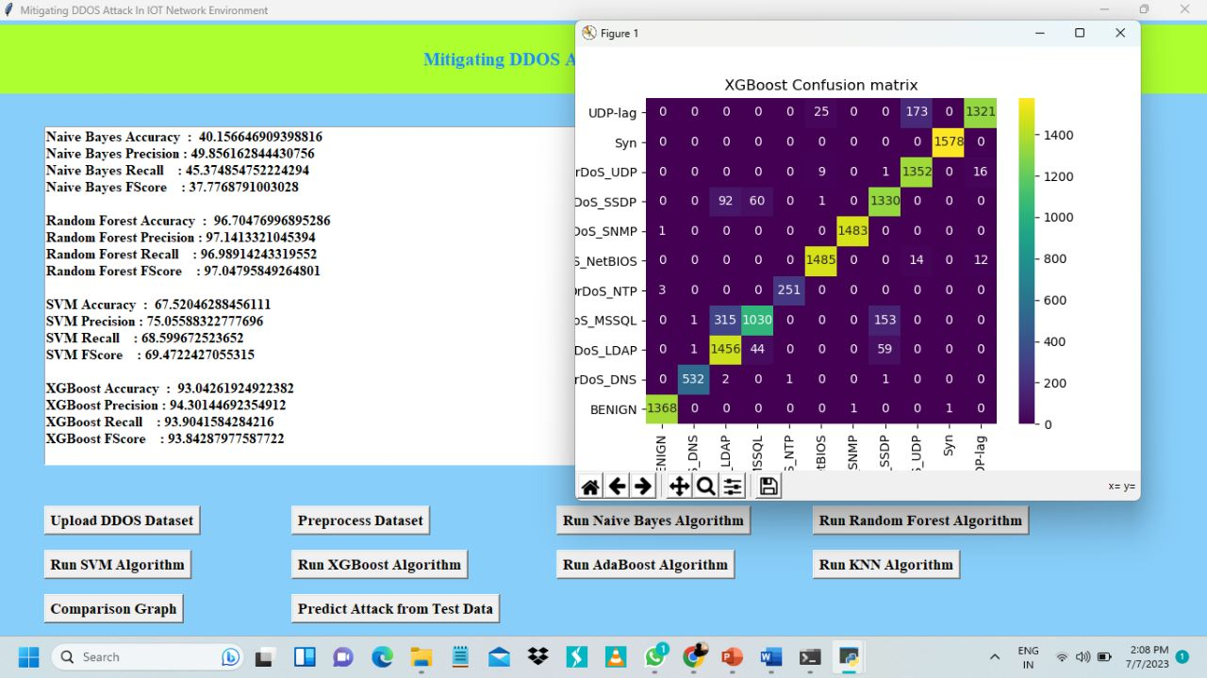
XGBOOST ALGORITHM

Slide 18
XGBOOST ALGORITHM
The XGBOOST algorithm is a machine learning technique used for regression and classification problems.
It is an ensemble learning method that combines multiple decision trees to make more accurate predictions.
The algorithm works by iteratively adding decision trees to the model, with each tree attempting to correct the errors made by the previous tree.
Objective Function: XGBoost aims to optimize an objective function by iteratively adding weak learners (decision trees) to the ensemble.
The test data with XGBOOST we got 92% accuracy.

Slide 19
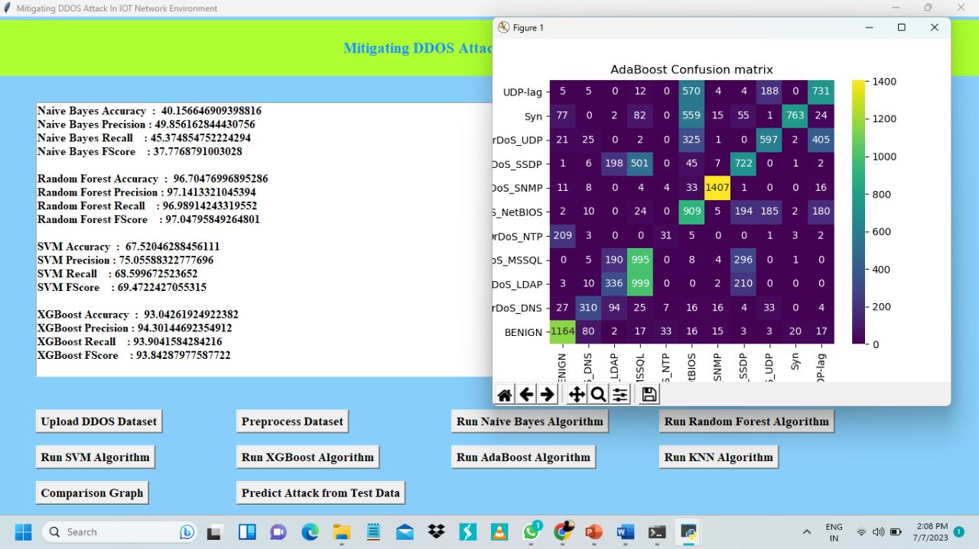
ADA BOOST ALGORITHM

Slide 20
ADA BOOST ALGORITHM
The ADABOOST algorithm is an ensemble learning method used for classification problems.
It works by iteratively adding weak classifiers to the model, with each classifier attempting to improve the accuracy of the previous classifiers.
One of the key strengths of ADABOOST is its ability to focus on the misclassified data points and give them higher weights, thereby improving the overall accuracy of the model.
The test data with ADABOOST we got 55% accuracy .

Slide 21
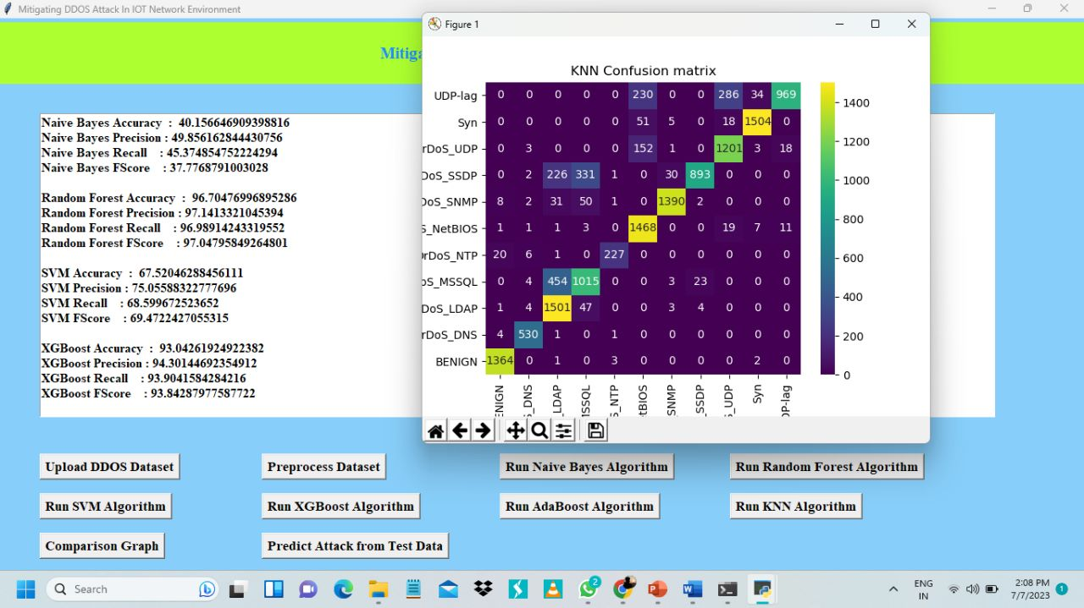
KNN ALGORITHM

Slide 22
KNN ALGORITHM
The K-Nearest Neighbors (KNN) algorithm is a non-parametric machine learning method used for classification and regression problems.
It works by finding the k-nearest data points in the training dataset to a new input data point, and then using the majority class or average value of those k-nearest neighbors as the predicted output.
This approach is simple yet effective, especially for datasets with high dimensionality and noisy data.
Euclidean Distance : Calculate the distance between the query point and all the training data points.
Formula : d(x, y) = sqrt((x1 - y1)^2 + (x2 - y2)^2 + ... + (xn - yn)^2).
Here, "d" represents the Euclidean distance between two points "x" and "y" .
Where,(x1, x2, ..., xn) and (y1, y2, ..., yn) represent the feature values of the two points along each dimension.
The test data with KNN we got 84% accuracy.

Slide 23
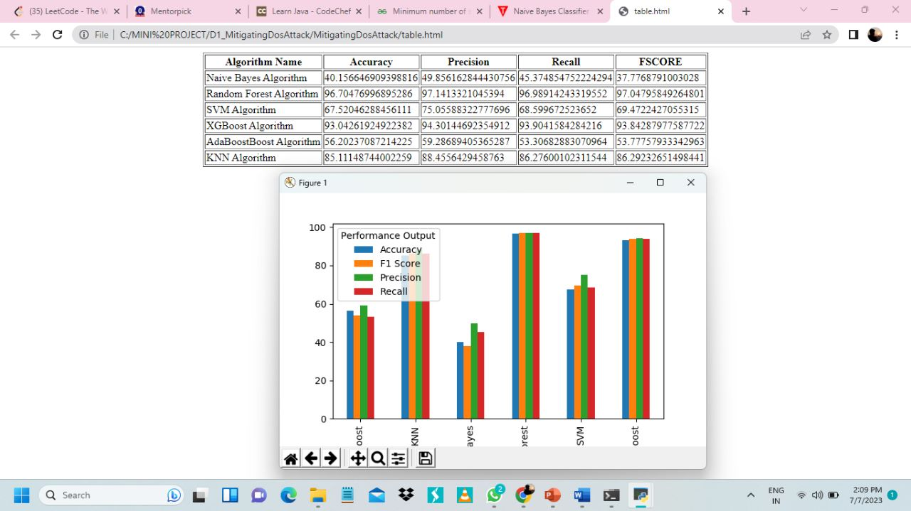
COMPARISON GRAPH

Slide 24
COMPARISON GRAPH
In the graph and comparison table we can see Random Forest algorithm got high accuracy.
In above graph different colour bar represents different metrics such as accuracy, precision, recall and f-score.
It works by plotting the accuracy of each algorithm on a graph and comparing them.
This method is useful in determining which algorithm is best suited for a particular dataset.
The COMPARISONGRAPH method is particularly useful when dealing with large datasets.

Slide 25
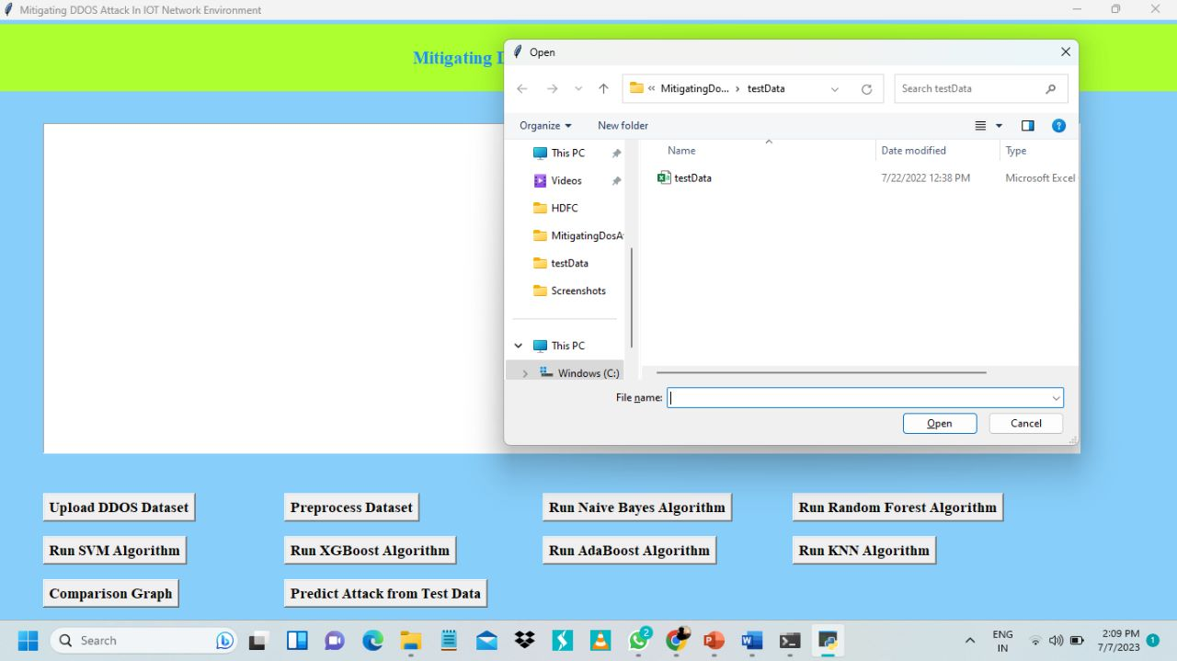
PREDICT ATTACK FROM TEST DATA
Using this module we will upload test data and then machine learning models will predict attack from that test data.
In above screen selecting and uploading Test data file and then click on ‘Open’ button to get output.

Slide 26
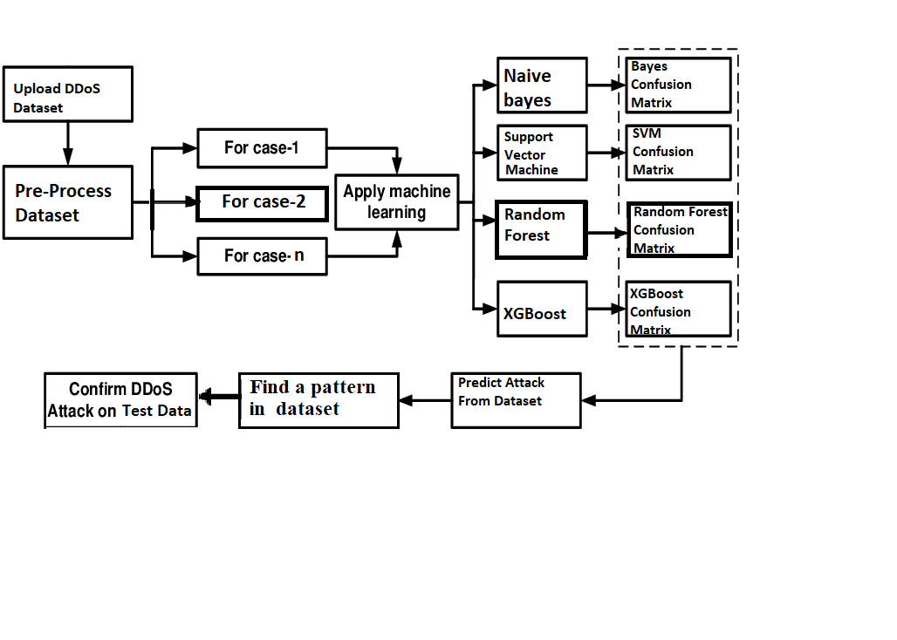
SYSTEM ARCHITECTURE

Slide 27
ADVANTAGES OF PROPOSED SYSTEM
Machine learning algorithms work by Analyzing network traffic patterns to identify abnormal behavior that may indicate a DDoS attack.
They are more adaptable to changing attack patterns and can detect attacks that may not fit a pre-defined set of rules.
They can learn from past attacks to improve their accuracy over time and reduce false positives.
High Efficiency
High Accuracy

Slide 28
REQUIREMENT SPECIFICATION
SOFTWARE REQUIREMENTS:
Python
Django
Mysql
MySqlClient
OPERATING SYSTEMS SUPPORTED :
Windows 7 or Above.

Slide 29

HARDWARE REQUIREMENTS
PROCESSOR : Intel i3 or Above.
RAM : 4 GB or Above.
HARD DISK : 128GB SSD or Above.
CPU : 1GHZ

Slide 30
MODULES
10 modules are used to run this project :
Upload DDos Dataset()
Run Preprocess Dataset()
Run Naive Bayes Algorithm()
Run Random Forest Algorithm()
Run SVM Algorithm()
Run XGBoost Algorithm()
Run AdaBoost Algorithm()
Run KNN Algorithm()
Comparison Graph()
Predict Attack From TestData()

Slide 31
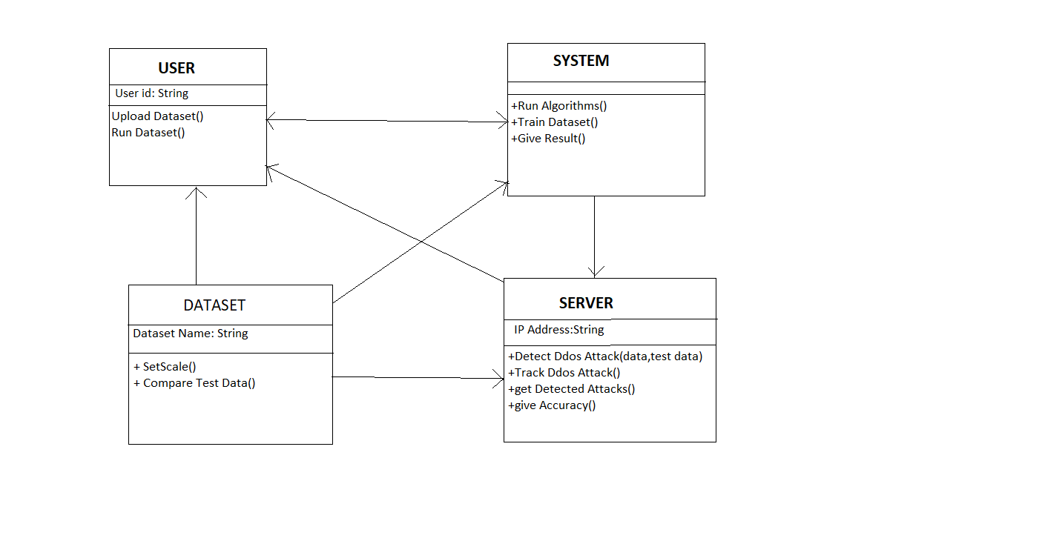
UML DIAGRAMS
CLASS DIAGRAM

Slide 32
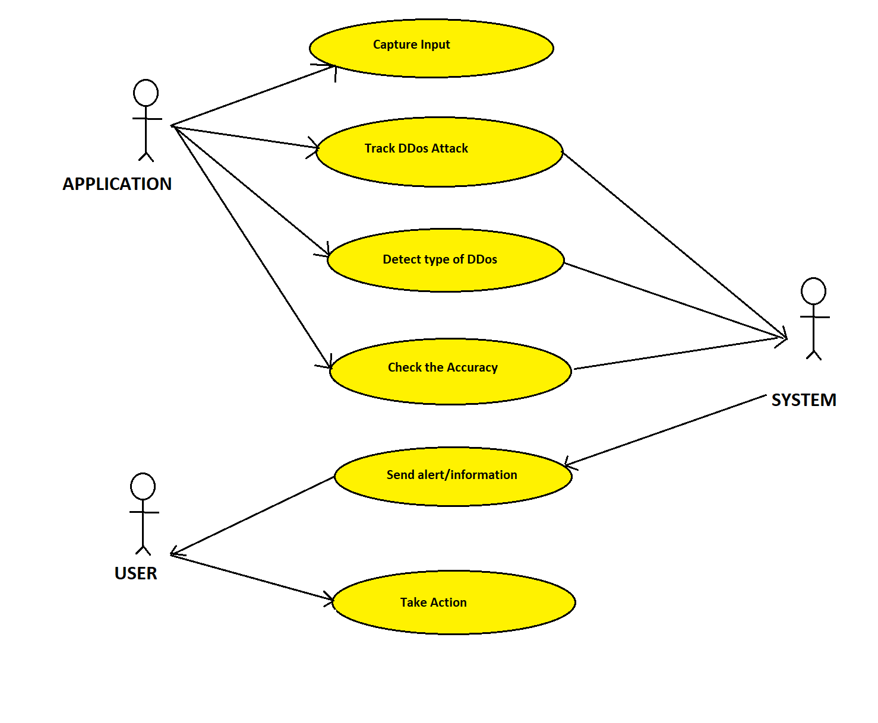
USECASE DIAGRAM

Slide 33
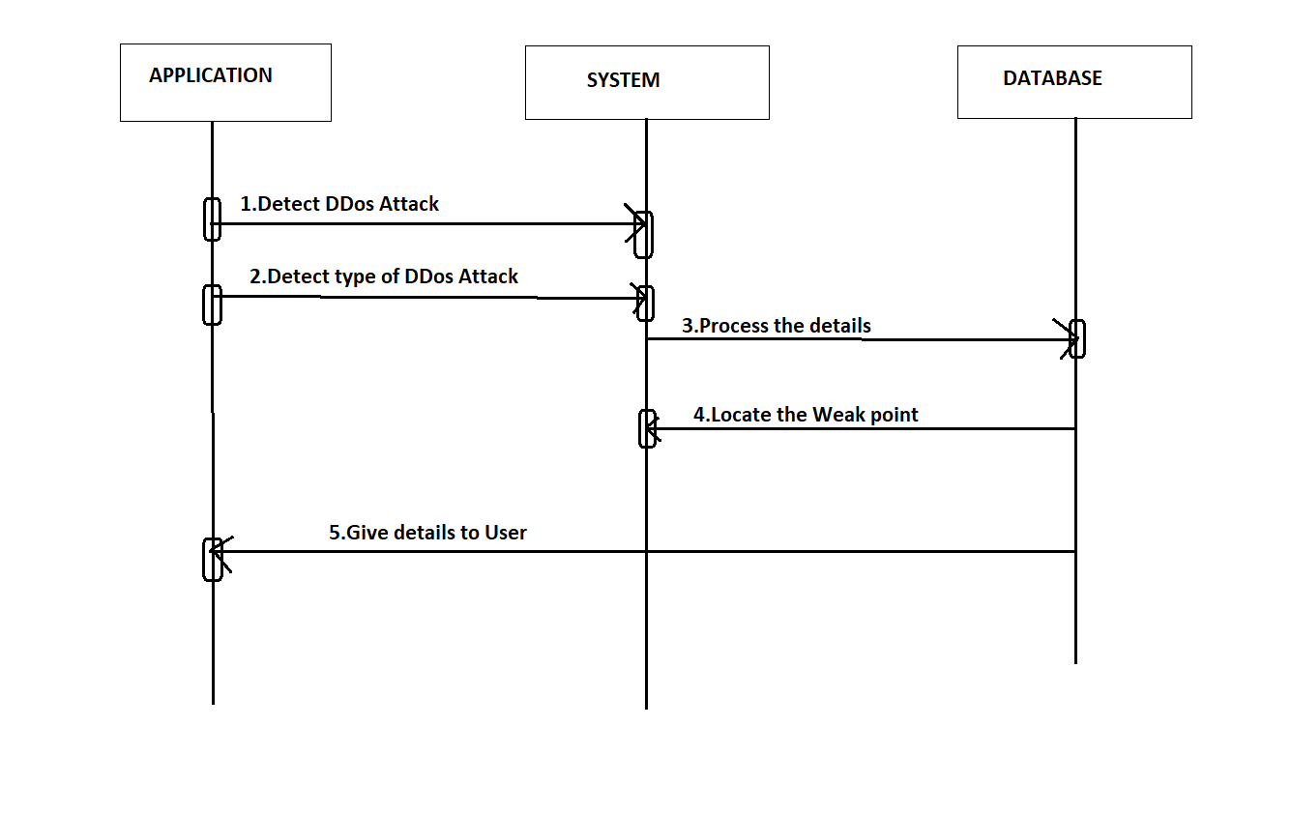
SEQUENCE DIAGRAM

Slide 34
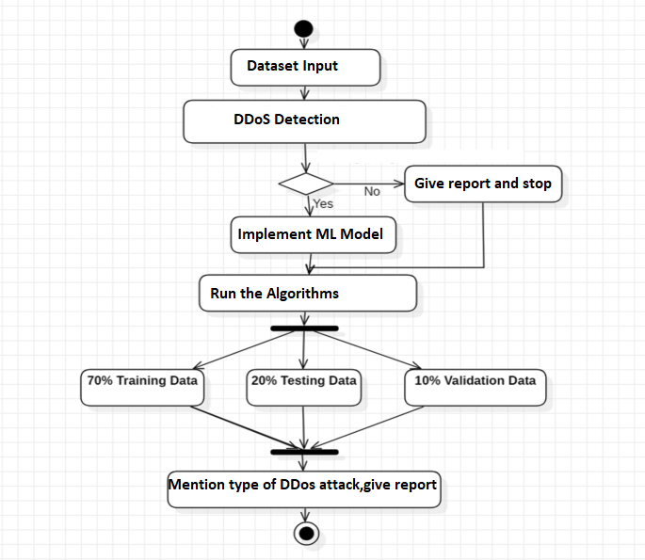
ACTIVITY DIAGRAM

Slide 35
NOVELTY OF PROJECT
The use of machine learning algorithms such as SVM, KNN, Random Forest, and Naive Bayes for mitigating DDoS attacks in IoT is a novel approach that has gained significant attention in recent years.
These algorithms are capable of detecting and preventing attacks in real-time, making them more effective than traditional methods. They can also adapt to changing attack patterns, making them more tough against evolving threats.
These algorithms have ability to learn from large amounts of data and identify patterns that may not be immediately apparent to human analysts.
This allows them to detect and respond to attacks more quickly and accurately, reducing the risk of damage to IoT devices and networks.

Slide 36
SAMPLE CODE
import matplotlib.pyplot as plt
import pandas as pd
import numpy as np
import os
import xgboost as xgb
global filename
global X,Y
global dataset
global main
global text
global accuracy, precision, recall, fscore
global X_train, X_test, y_train, y_test
global classifier
global label_encoder, labels, columns, types, pca
main = tkinter.Tk()
main.title("Mitigating DDOS Attack In IOT Network Environment") #designing main screen
main.geometry("1300x1200")

Slide 37
SAMPLE CODE
def runRandomForest():
global classifier
if os.path.exists('model/rf.txt'):
with open('model/rf.txt', 'rb') as file:
rf = pickle.load(file)
file.close()
else:
rf = RandomForestClassifier()
rf.fit(X_train, y_train)
with open('model/rf.txt', 'wb') as file:
pickle.dump(rf, file)
file.close()
predict = rf.predict(X_test)
classifier = rf
calculateMetrics("Random Forest", predict, y_test)

Slide 38
SAMPLE CODE
def runKNN():
if os.path.exists('model/knn.txt'):
with open('model/knn.txt', 'rb') as file:
knn_cls = pickle.load(file)
file.close()
else:
knn_cls = KNeighborsClassifier(n_neighbors = 2)
knn_cls.fit(X_train, y_train)
with open('model/knn.txt', 'wb') as file:
pickle.dump(knn_cls, file)
file.close()
predict = knn_cls.predict(X_test)

Slide 39
SAMPLE CODE
def runAdaBoost():
if os.path.exists('model/adb.txt'):
with open('model/adb.txt', 'rb') as file:
adb_cls = pickle.load(file)
file.close()
else:
adb_cls = AdaBoostClassifier()
adb_cls.fit(X_train, y_train)
with open('model/adb.txt', 'wb') as file:
pickle.dump(adb_cls, file)
file.close()
predict = adb_cls.predict(X_test)
calculateMetrics("AdaBoost", predict, y_test) calculateMetrics("KNN", predict, y_test)

Slide 40
RESULTS
We can say with the increasing of accuracy and effectiveness of the project ,the machine learning algorithms can easily predict many types of DDoS attacks.
As a result ,we can decrease false-positive rate through this model.
By considering many machine learning algorithms, we can find the attack in one or other way.
It gives Robust features such that it can predict different types of attacks.

Slide 41
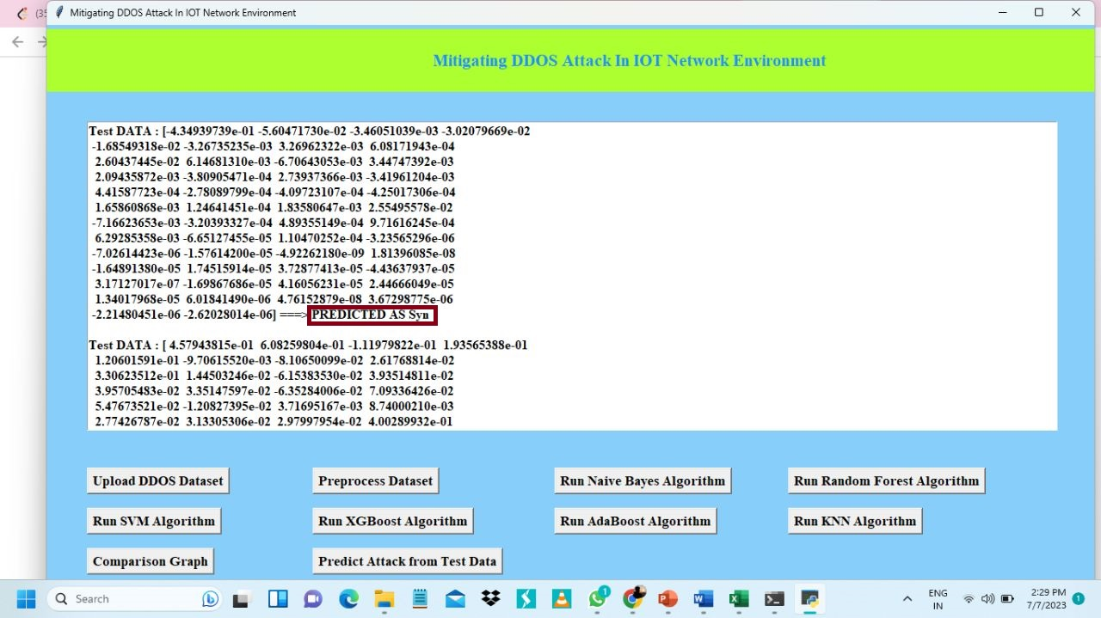
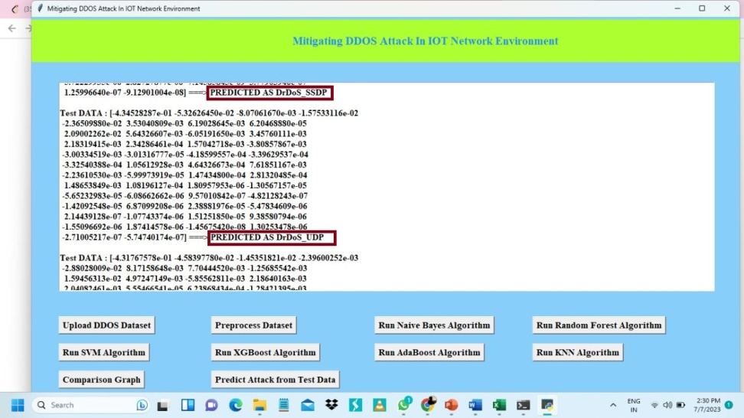
In the above screen in square bracket we can see TEST DATA features and after arrow symbol ➔ We can see predicted ATTACK as ‘SYN’. We can see predicted ATTACK as ‘DrDos SNDP’. We can see predicted ATTACK as ‘DrDos UDP’.

Slide 42
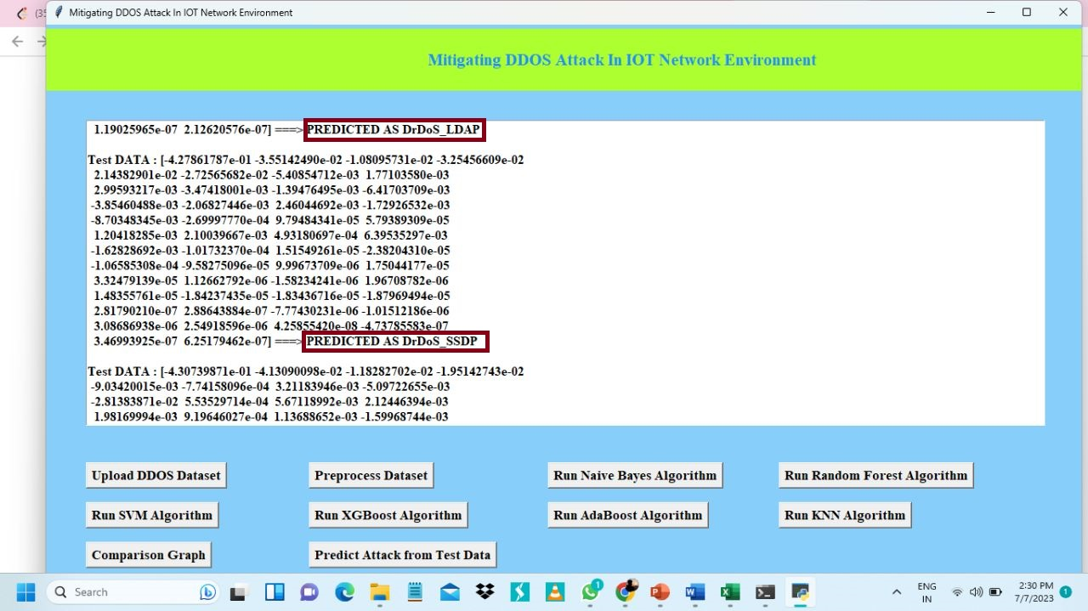
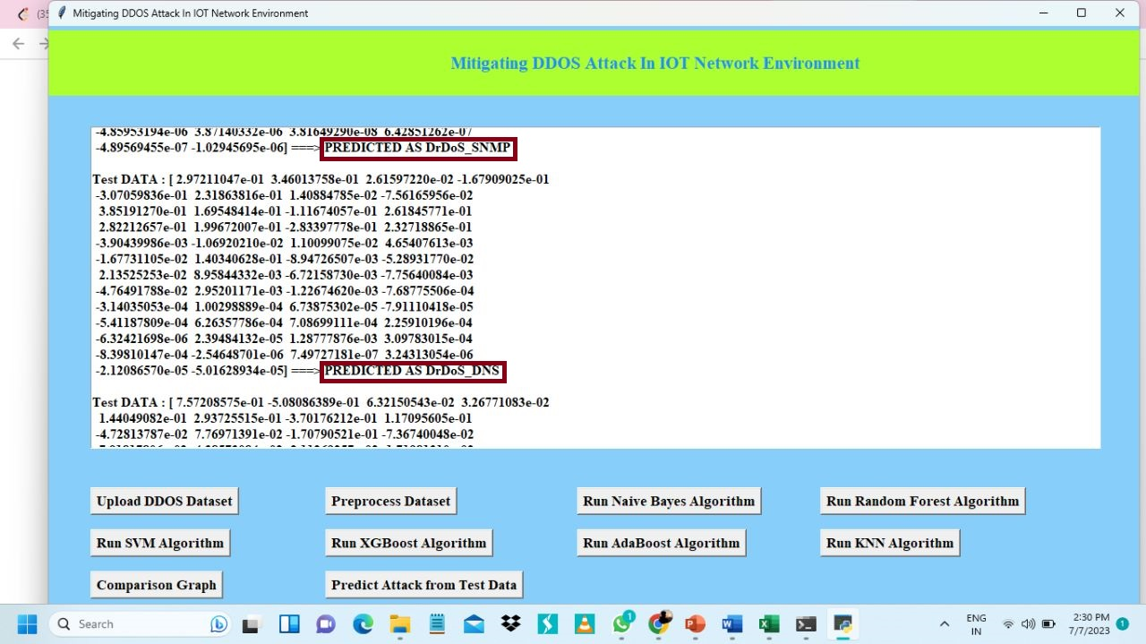
In the above screen in square bracket we can see TEST DATA features and after arrow symbol ➔ we can see predicted ATTACK as ‘DrDos _LDAP’. We can see predicted ATTACK as ‘DrDos_ SSDP’. We can see predicted ATTACK as ‘DrDos _SNMP’. We can see predicted ATTACK as ‘DrDos _DNS’. In above screens with each different test records different attacks are predicted.

Slide 43
FUTURE SCOPE
Integration with Existing Security Solutions:
The project could lead to the integration of machine learning-based DDoS mitigation techniques into existing security products and services.
This integration can enhance the overall cybersecurity.
Real-time Detection:
Enhance project's ability to detect and respond to DDoS attacks in real-time.
This can involve optimizing algorithms for implementing streaming data processing, and integrating with network monitoring tools.

Slide 44
FUTURE SCOPE
Anomaly Detection:
Exploring anomaly detection techniques to identify unusual traffic patterns that might indicate DDoS attacks.
Data Augmentation:
Experiment with data augmentation techniques to increase the diversity and size of your training dataset.
This can lead to better generalization and robustness of machine learning models.
Large-scale Testing:
Conduct extensive testing of the system in a controlled environment to assess its scalability and performance under heavy DDoS attack scenarios.

Slide 45
CONCLUSION
Machine learning algorithms like SVM, KNN, Random Forest, and Naive Bayes provide significant advantages for mitigating DDoS attacks in IoT.
These algorithms are capable of detecting and preventing attacks in real-time, making them more effective than traditional methods.
Additionally, they can adapt to changing attack patterns, making them more resilient against evolving threats.
By implementing these algorithms, organizations can significantly improve their security posture and protect their IoT devices from malicious attacks.
As the number of connected devices continues to grow, it is essential to consider these advanced security measures to ensure the safety and privacy of sensitive data.

Slide 46
REFERENCES
1. Title: "Anomaly-Based DDoS Detection and Mitigation in IoT Networks: A Review"
Authors: I. Ahmed, A. Mahmood, S. Hu, and H. Hu
Published in: IEEE Access, 2021
2. Title: "A Survey of DDoS Attacks and Defense Mechanisms in IoT"
Authors: A. Amatullah, S. Gupta, and M. H. Bhuyan
Published in: IEEE Internet of Things Journal, 2020
3.Title: "Detecting DDoS Attacks in IoT Networks: A Machine Learning-Based Approach"
Authors: S. Kaushik, M. S. Obaidat, and N. Gupta
Published in: Future Generation Computer Systems, 2019
4.Title: "Machine Learning for IoT Security: Improving Network Intrusion Detection"
Authors: S. Mahbub, M. H. Bhuiyan, and S. Roy
Published in: IEEE Internet of Things Journal, 2017

Slide 47
GITHUB LINK
Github Link for Mitigating DDOS Attack In IOT Network Environment :
https://github.com/venkatesh944/mitigating_ddos_attack

Slide 48
THANK YOU!!

